Slide 1

Department of Artificial Intelligence and Data Science
A Deep Learning Framework for Translating Tamil Sign Language Gestures into Speech
NIKILESH S-221801035
POONGAVIN B -221801036
SUKISH M -221801053
Dr. A. BEULAH
ASST.PROFESSOR

Slide 2
Problem Statement and Motivation
Problem Statement
Communication between hearing-impaired individuals and others is difficult due to the lack of common understanding of sign language. Existing systems rarely support Tamil Sign Language, making interaction challenging. Hence, there is a need for an automated system that can accurately recognize Tamil hand gestures and translate them into readable text.
Motivation
This project aims to promote inclusive communication for the hearing and speech-impaired community. By using Mediapipe for hand tracking and CNN for gesture classification, the system enables real-time Tamil gesture recognition, helping bridge the communication gap effectively.

Slide 3
Existing System
Sign language recognition currently relies on manual interpretation, and there is no fully automated Tamil Sign Language (TSL) recognition system available.
Existing systems are mainly designed for ASL or ISL, leading to poor performance and lack of support for TSL gestures.
Traditional image-processing approaches depend on hand-crafted features, which gives low accuracy and weak gesture understanding.
Sensor-based or hardware-based solutions (like gloves/Kinect) are expensive, non-portable, and impractical for daily use.
Existing solutions often fail to provide a complete pipeline (gesture → text → speech), making real-time communication difficult.

Slide 4
Objectives
To develop a deep learning–based model capable of accurately recognizing Tamil Sign Language (TSL) hand gestures.
To use MediaPipe Hand Landmark extraction and classify gestures with a suitable neural network model.
To convert the recognized gesture into text output for better accessibility and understanding.
To generate speech output from the predicted text to enable real-time communication.
To build a simple, user-friendly system that supports smooth, real-time translation of TSL gestures into meaningful speech.

Slide 5
Abstract
Communication barriers remain a major challenge for the Tamil-speaking deaf and mute community.
There is a need for a deep learning solution that can translate Tamil Sign Language (TSL) into spoken or written Tamil.
The proposed framework uses MediaPipe Hand Landmark Detection to extract 21 key hand points from TSL gesture images.
A Convolutional Neural Network (CNN) processes these spatial features to learn gesture patterns and classify TSL alphabets accurately.
The study aims to develop a scalable TSL gesture-to-text and speech system, forming the foundation for future real-time applications that improve communication accessibility.

Slide 6
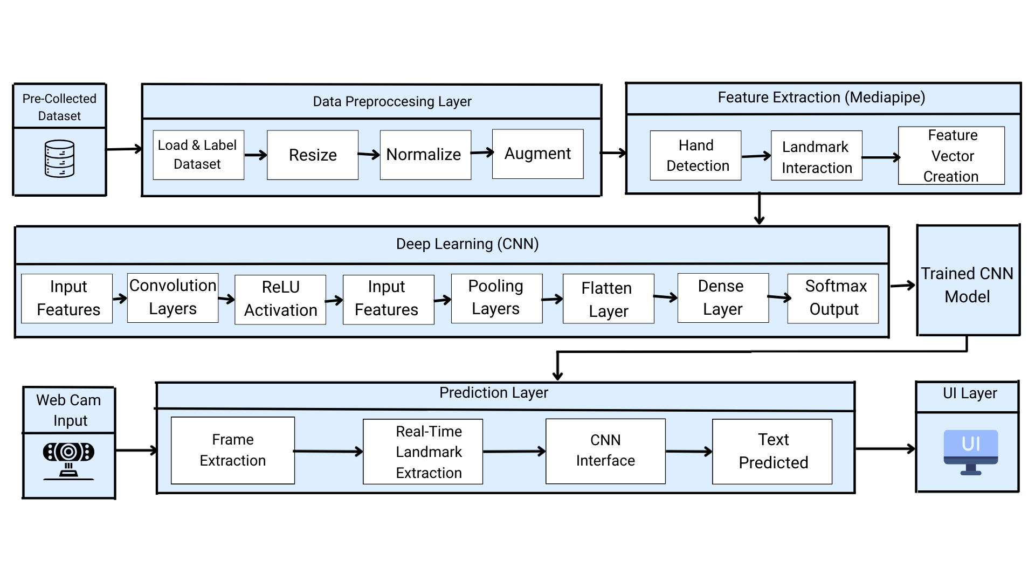
Architecture(framework)

Slide 7
Module
Dataset Preparation Module
Collect and organize Tamil hand-sign images into labeled folders (one class per sign).
Load images using image_dataset_from_directory().
Resize all images to 224 × 224 and assign labels automatically based on folder names.
Preprocessing & Normalization Module
Apply normalization using Rescaling(1./255) to scale pixel values from [0, 255] → [0, 1].
Optimize pipeline using cache, shuffle, prefetch for faster training.
Visualize random preprocessed samples to verify correct input format.

Slide 8
Module
Data Augmentation Module
Apply augmentation techniques to increase dataset diversity:
Horizontal flip
Rotation
Zoom
Contrast adjustment
Brightness variation

Slide 9
Module
Feature Extraction & CNN Model Module
Design and implement a CNN model (or use ResNet50 as backbone).
Extract spatial features from hand-sign images.
Use Conv2D, MaxPooling, Flatten, Dense, and Dropout layers for feature learning.
Classification & Training Module
Train the CNN model on the preprocessed and augmented dataset.
Monitor training curves (loss and accuracy) to analyze model performance.
Save the trained model for later use in prediction.

Slide 10
Module
Prediction & Output
Load the trained CNN model.
Take a test image (or webcam frame), preprocess it (resize + normalize), and predict its class.
Map the predicted class to the corresponding Tamil letter/gesture label.
Display the recognized Tamil character as text output (and optionally speech in future work).

Slide 11
Conclusion
The project successfully developed the foundational stages of a Tamil Sign Language–to–Text recognition system using deep learning. Through proper dataset loading, preprocessing, normalization, and augmentation, high-quality inputs were prepared for effective model learning. The implemented CNN demonstrates the ability to recognize and classify Tamil hand gestures, establishing a reliable framework for further system enhancement. Overall, the work provides a strong step toward real-time, accessible communication support for the Tamil deaf and dem
community.

Slide 12
Thank You

